Slide 1

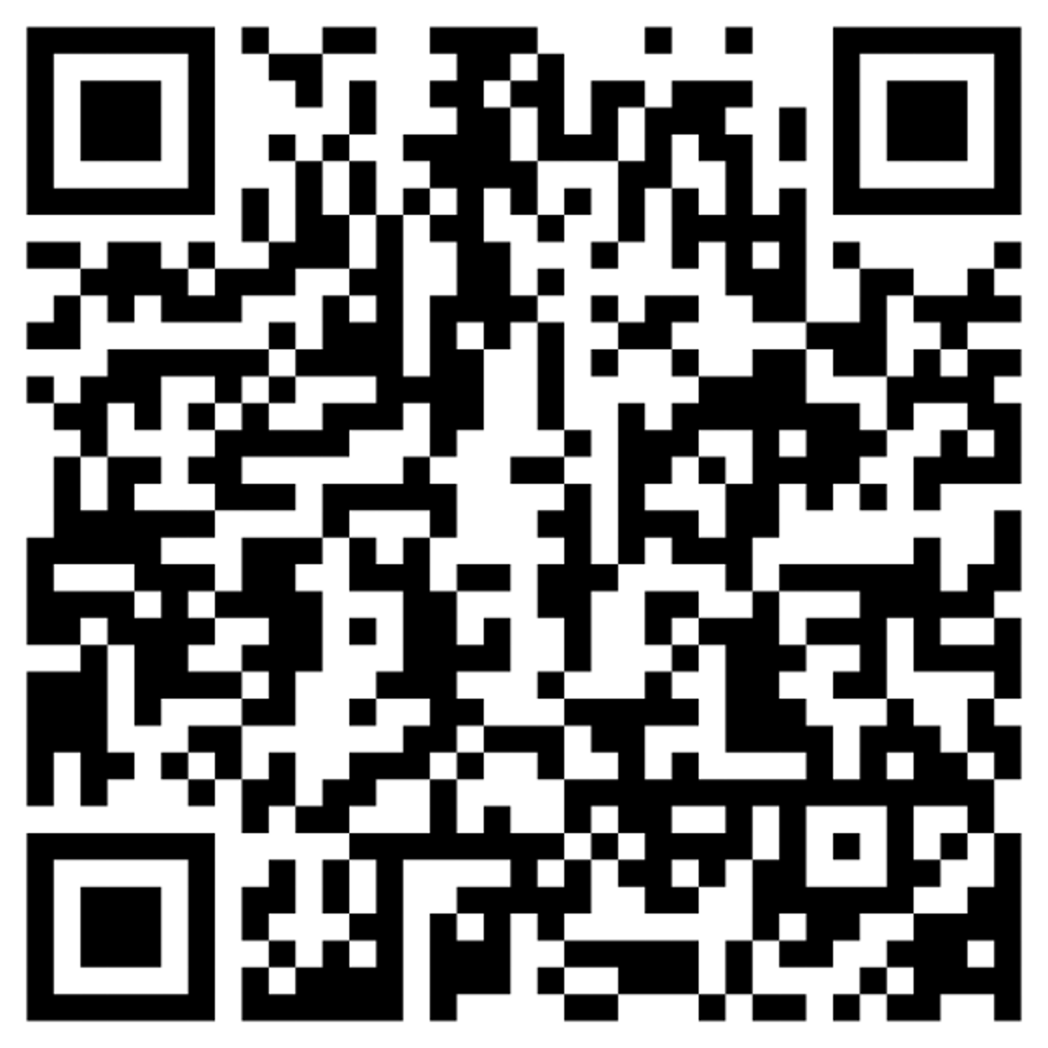
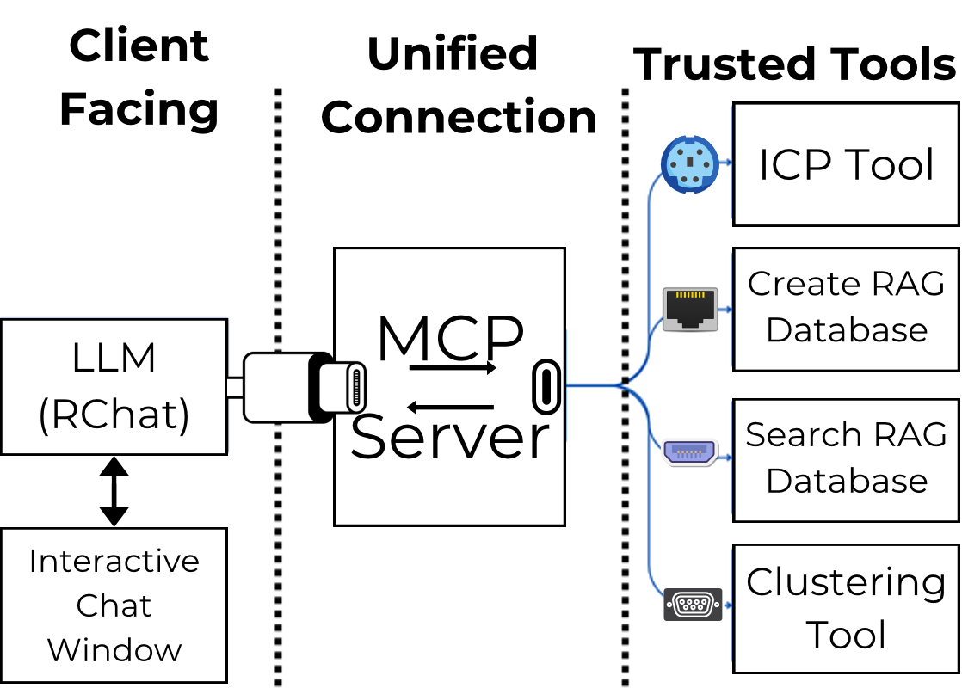
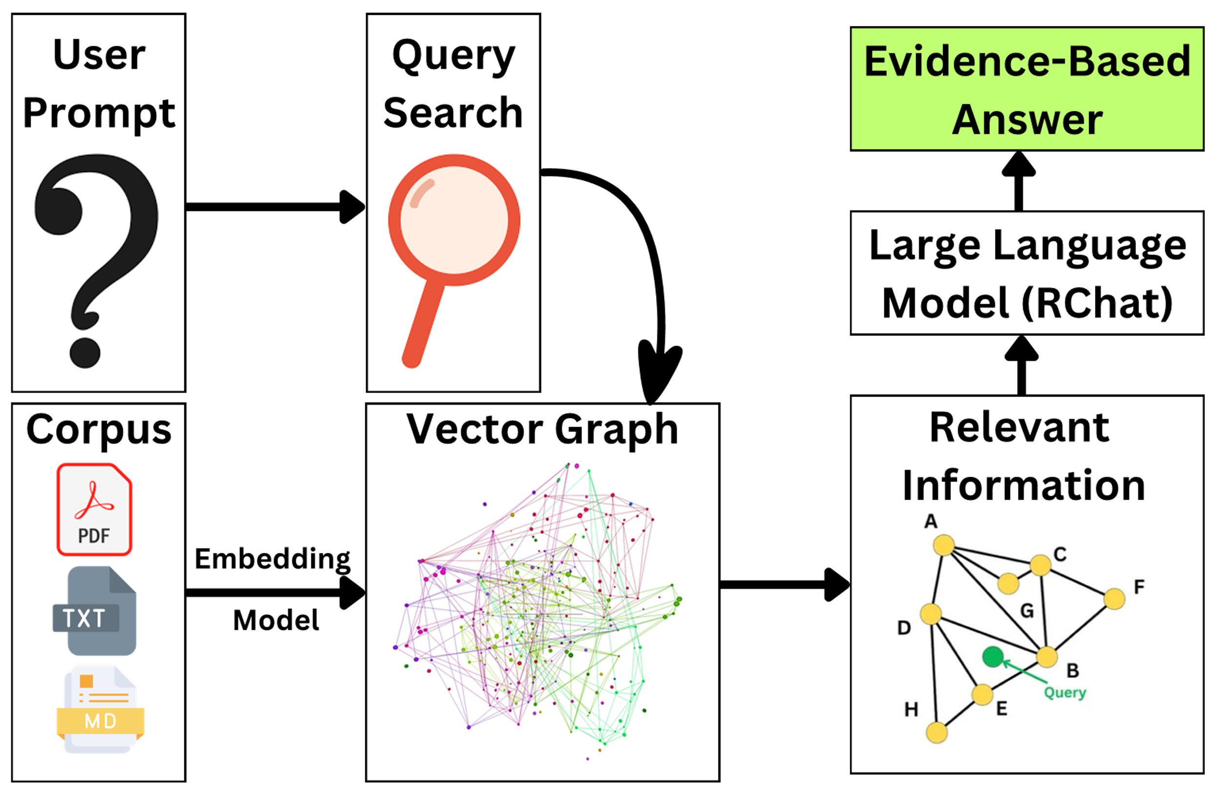
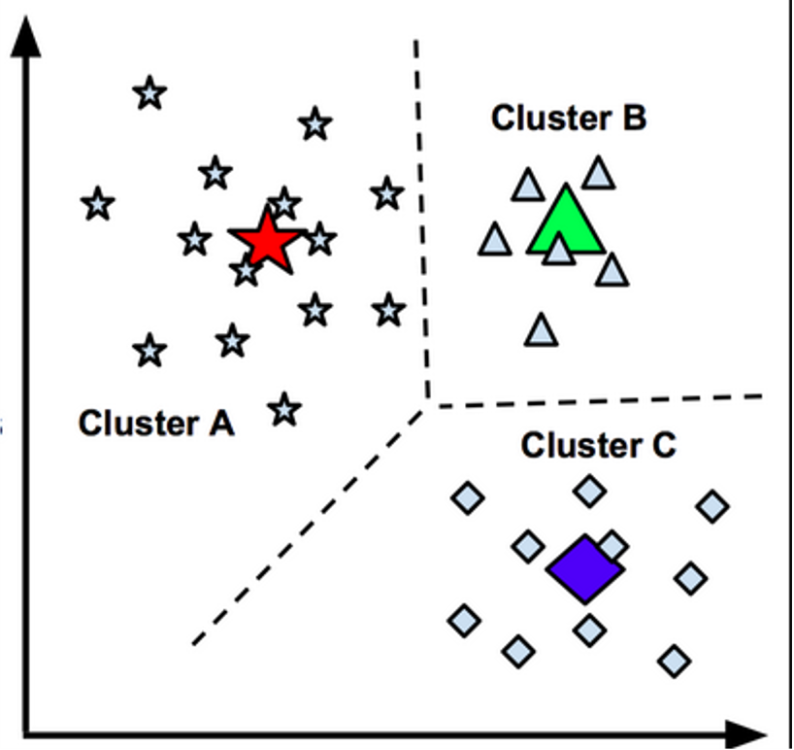
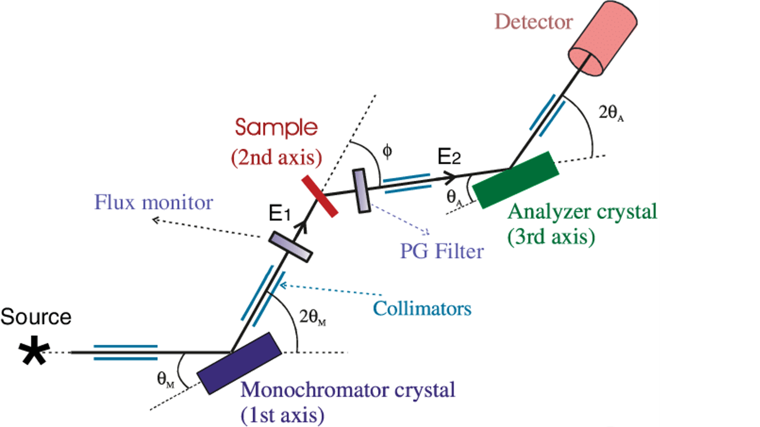
Applications of Large Language Models and AI to Neutron Scattering
Aditya Purohit, Richard Montgomery High School
Mentor: Dr. William Ratcliff
National Institutes of Standards and Technology Center for Neutron Research
Abstract & Methodology
Video Demos:
This project explores the integration of large language models (LLMs) to enhance neutron scattering and research workflows at the NIST Center for Neutron Research (NCNR). As a user facility, the NCNR serves many researchers who may not have deep familiarity with each instrument's capabilities or relevant prior work. By leveraging the Model Context Protocol (MCP), LLMs can access accurate, validated tools and data sources. Key components include an Instrument Control Program (ICP) tool that translates motor positions into physical coordinates via a chat interface, and a Retrieval-Augmented Generation (RAG) system that enables fast, targeted searches across NCNR publications. Additional efforts include integrating AI for document classification and semantic search to streamline the proposal review process. These tools collectively help users better understand instruments, speed up scientific preparation, and support more efficient research at the NCNR.
Lattice Calculator Tool
Retrieval Augmented Generation (RAG) for BT7 Instrument
Proposal Classifier Tool
Model Context Protocol
Clustering Background
Clustering groups similar data without labels to find natural patterns.
Retrieval Augmented Generation
Tool Description
The Instrument Control Program (ICP) tool computes motor angles for triple-axis spectrometers based on crystallographic inputs, targeting specific points in reciprocal space. Integrated with a Large Language Model (LLM), it allows users to describe setups naturally via a chat interface.
BT7 RAG Tool
The BT7 RAG tool uses a database of NCNR papers from 2016–17 to help researchers quickly reference relevant experimental setups, parameters, and results. By linking natural language queries to past BT7 studies, it streamlines experiment planning and enhances understanding of the instrument’s capabilities.
Tool Description
The Proposal Classifier tool uses semantic search and RAG-based clustering to organize incoming NCNR proposals by scientific themes. This aids staff in streamlining the review process, highlighting overlaps, and surfacing relevant prior work to support more informed evaluation.
Results
Creates clusters and keywords to describe them
Inputs and outputs through file path, no transferring required
Allows for iteration to make focused proposal packages
Future Directions
Add reviewers to keywords and have auto-assignment packages
Results
More efficient literature search
Increases the accuracy of outputs
Chat interface that creates a coherent response from the data
Future Directions
Customize to add the documents of different instruments and facilities
Results
Natural interface
Will Allow Interactions with other tools e.g. instrument resolution
Will Help Users Plan Experiments
Future Directions
Integration with other tools to allow for a seamless workflow
References:
Dasila, M. S. (2019, May 1). Basics: K‑means clustering algorithm. Medium. Retrieved from https://medium.com/@msdasila90/basics‑k‑means‑clustering‑algorithm‑a77c539c9e00
Li, G., Bentoumi, G., Tun, Z., Li, L., & Sur, B. (2016, July 26). Thermal neutron scattering cross-section measurements of heavy water. CNL Nuclear Review, 1–7. https://doi.org/10.12943/CNR.2016.00008
Acknowledgements:
William Ratcliff for guiding me throughout this process
Paul Kienzle for setting up key infrastructure and reviewing poster
Julie Borchers for helping with all the administrative processes
SHIP Program for giving me the opportunity learn from my mentor

